Slide 1



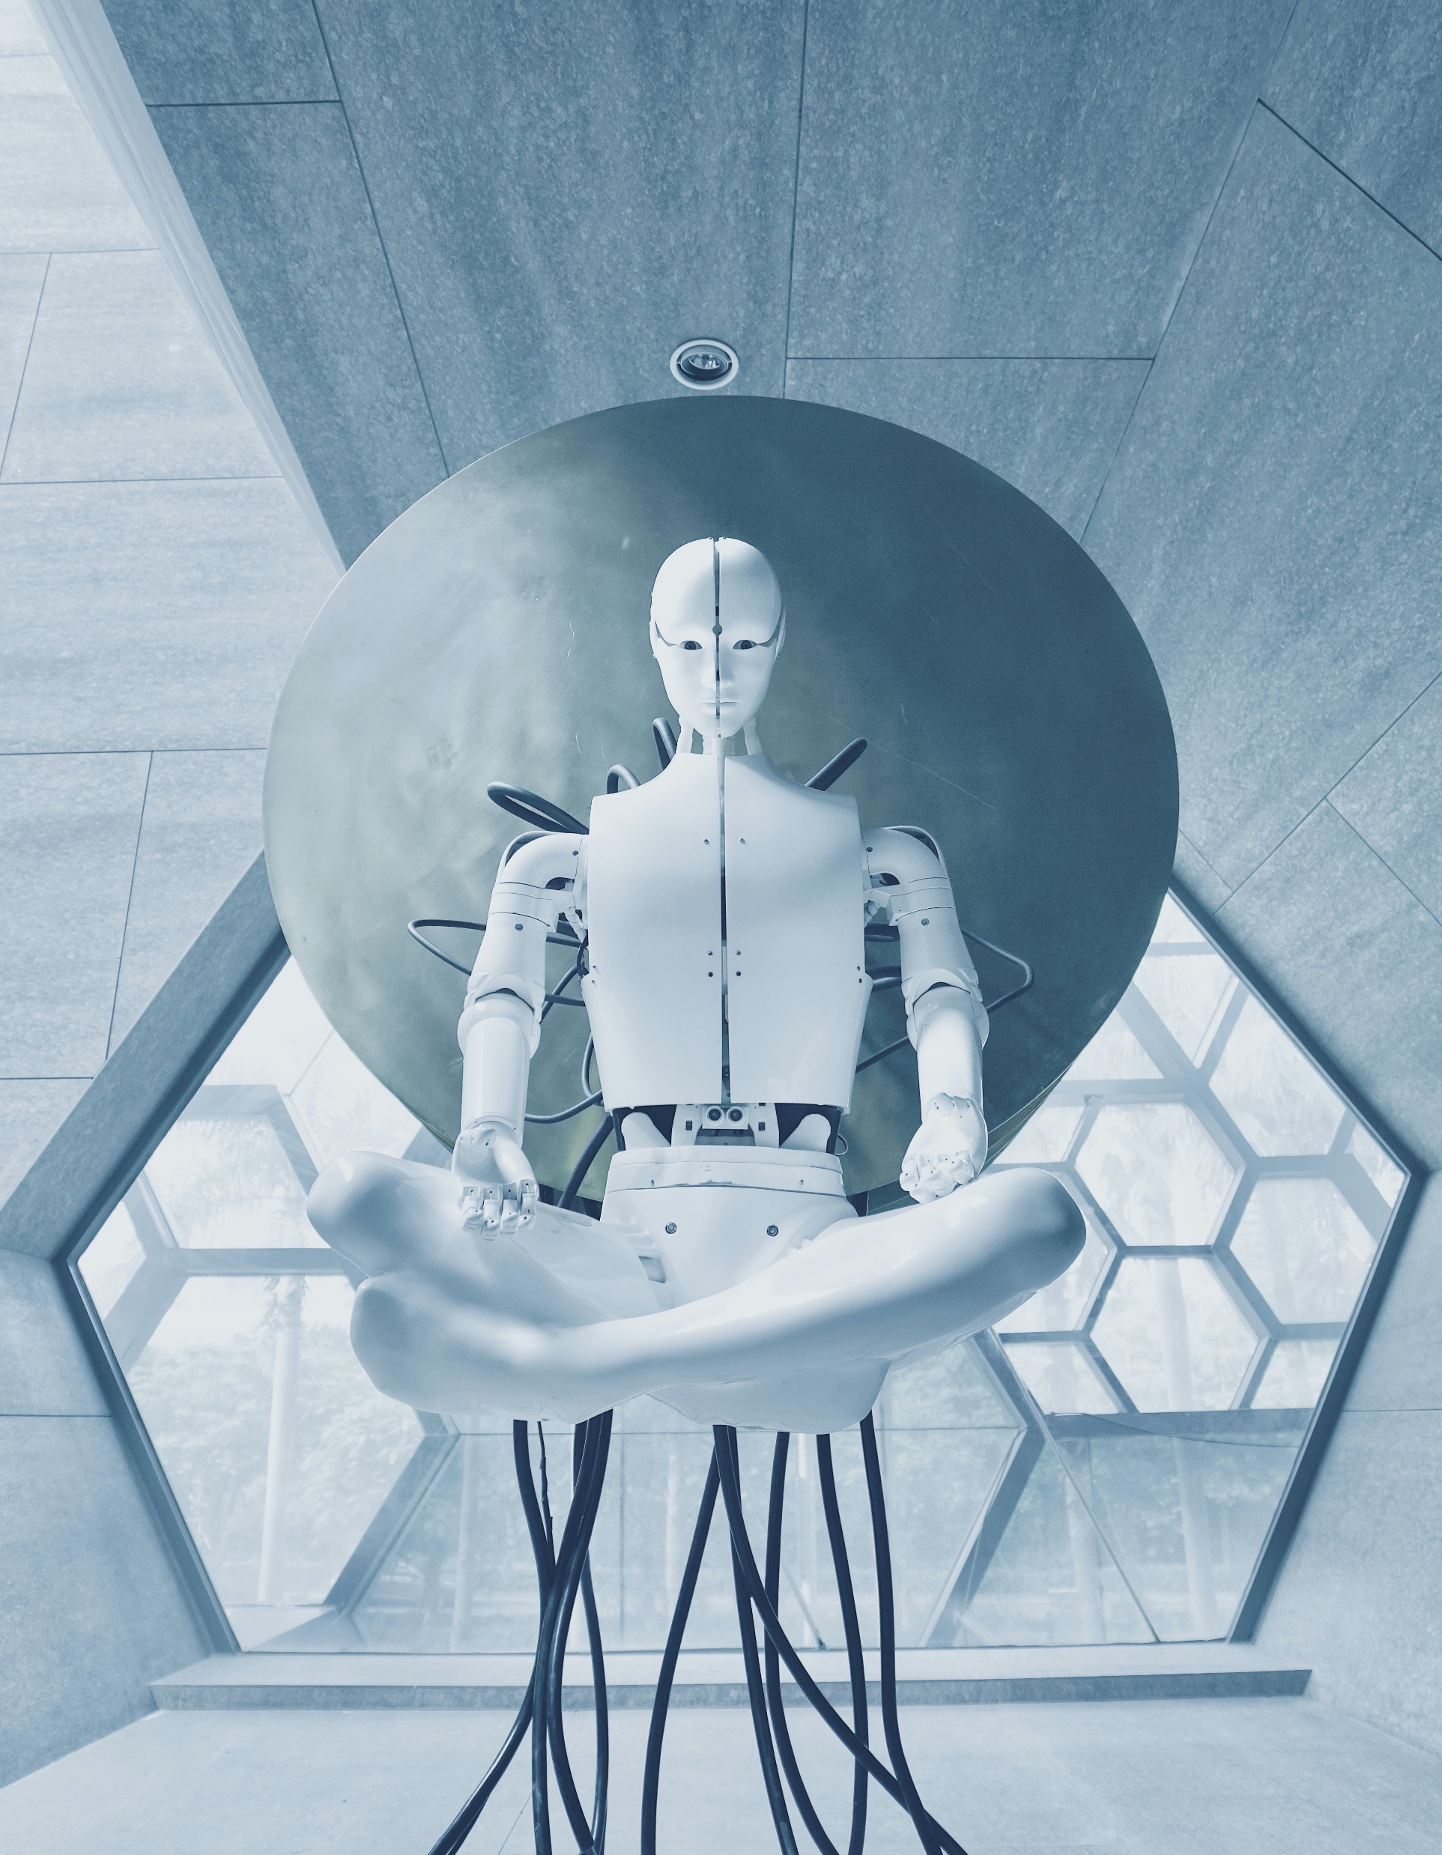
Code Sensei
COMP-4500
Group Members: Zainab Latif, Hamza Baig, Ameya Ade, and Abhishek Yawalkar
Project Webpage - latifz.github.io
Notes:
Reference: Photo by Aideal Hwa on Unsplash

Slide 2
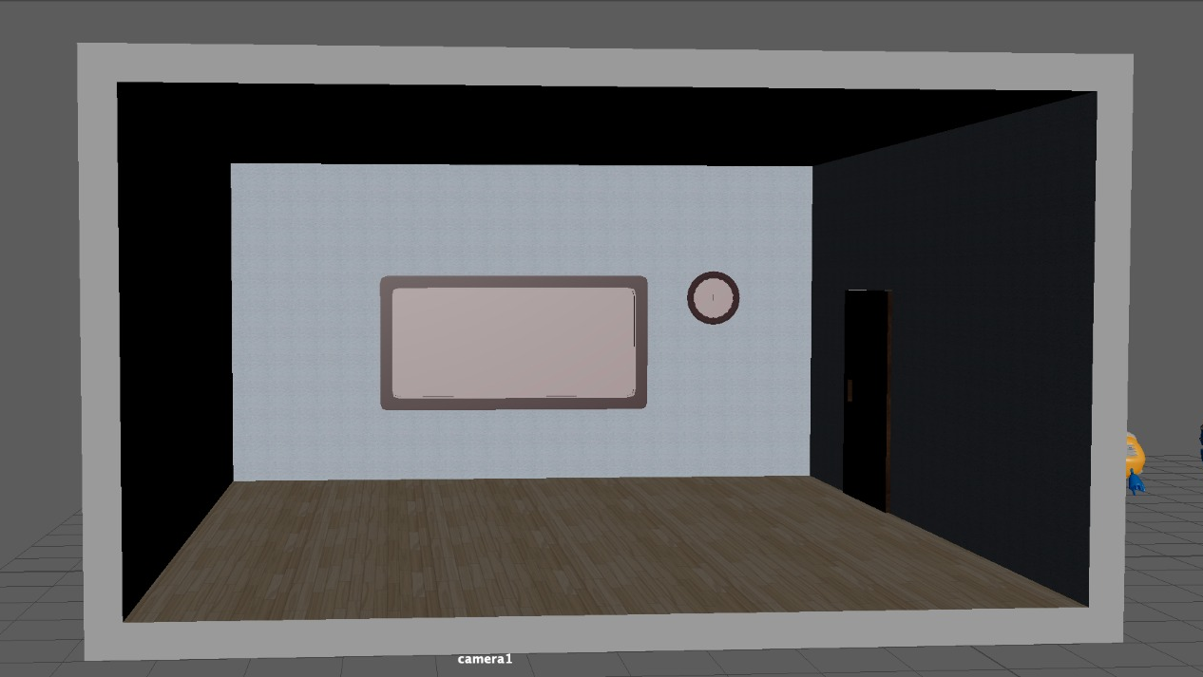

Slide 3

MODELS

Slide 4
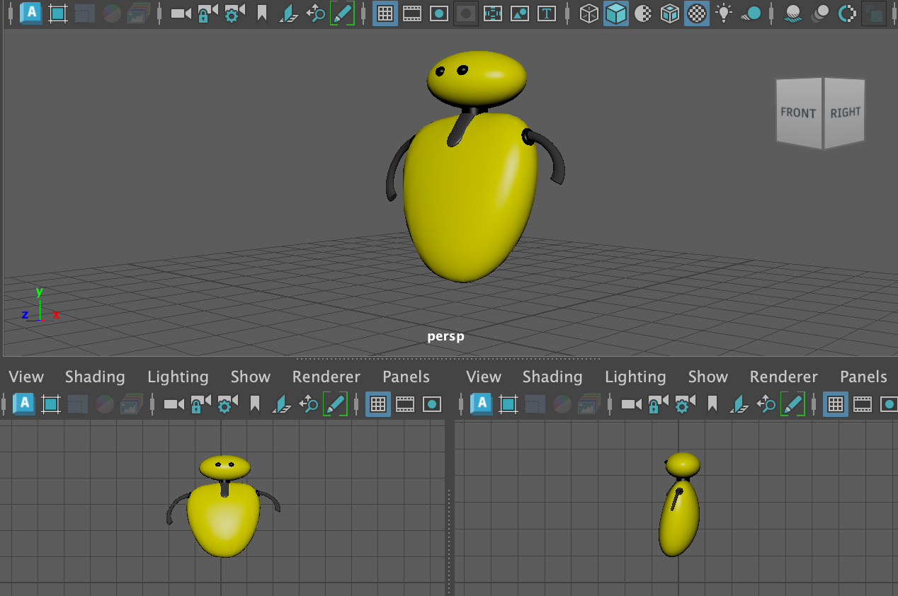
Code
Sensei

Slide 5
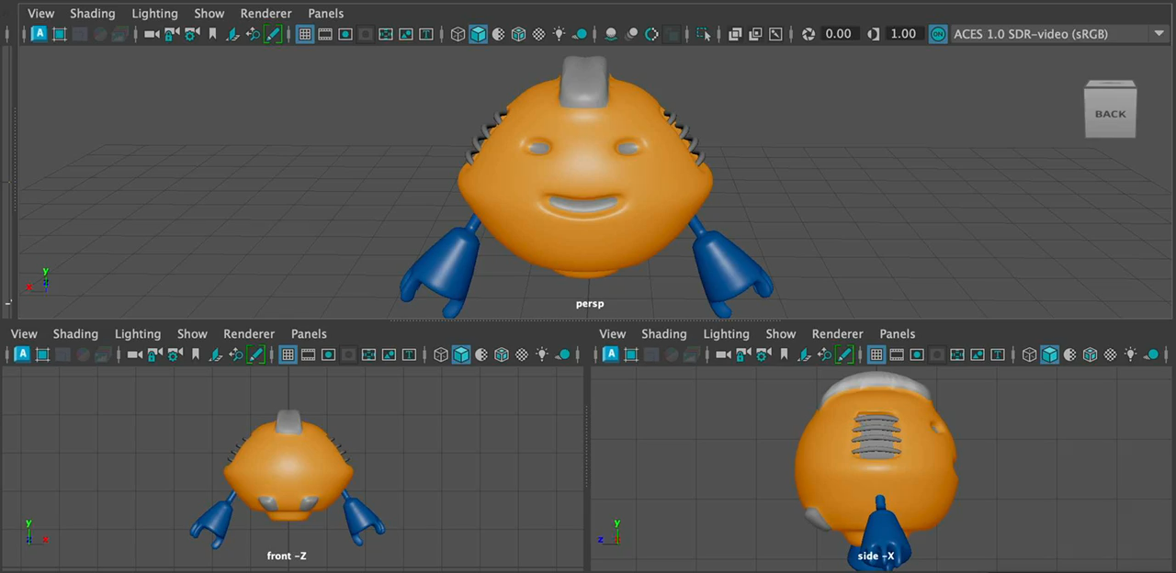
Student
Robot #1

Slide 6
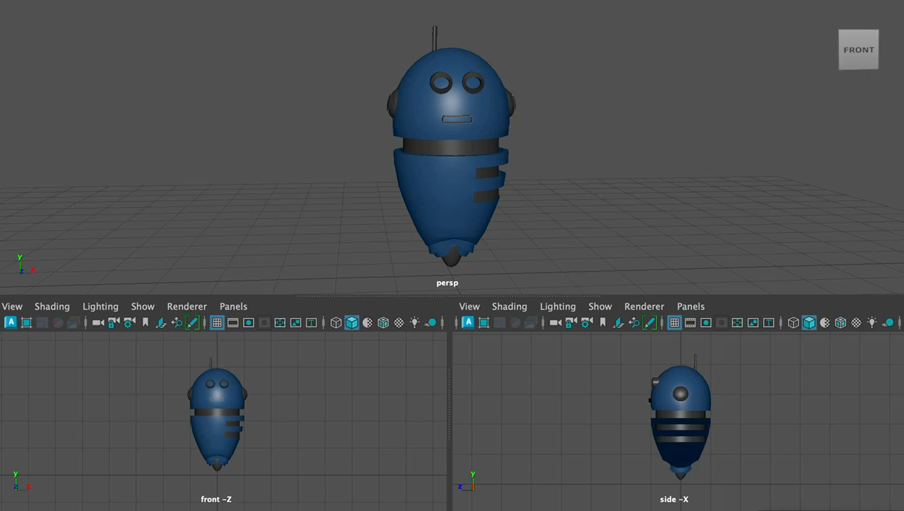
Student
Robot #2

Slide 7
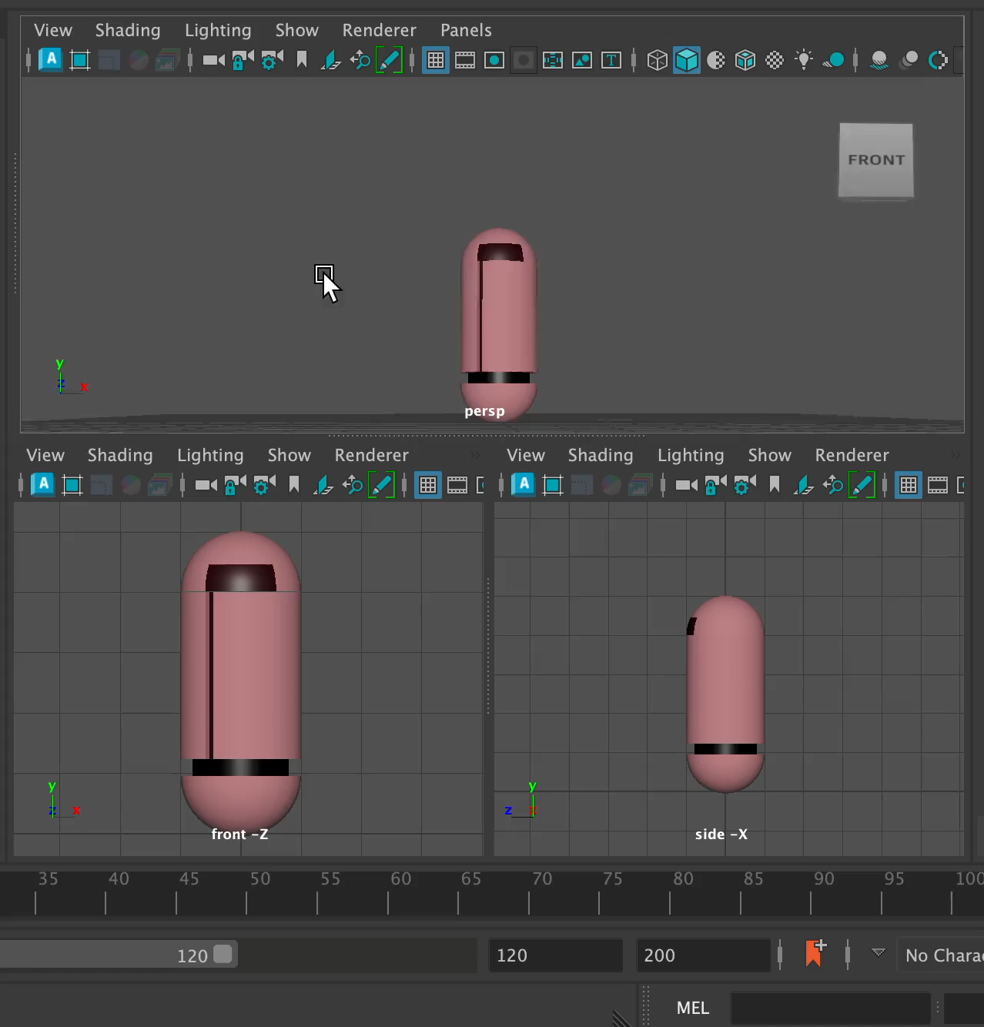
Student
Robot #3

Slide 8
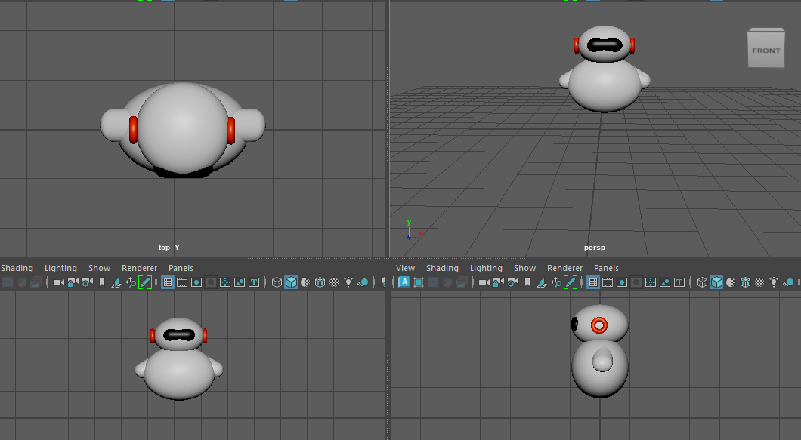
Student
Robot #4

Slide 9
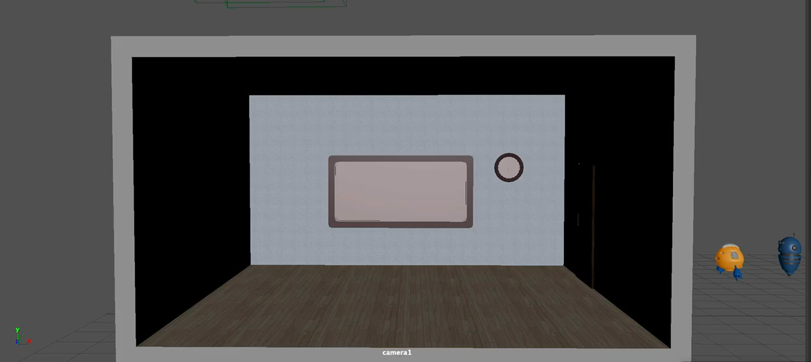
Sensei and Students Enter Classroom

Slide 10
Voiceovers
We have created the voiceovers to be used in the animation.
Notes:
https://github.com/hamzaBaig1998/COMP-4500/tree/main/audios

Slide 11

Computational Time
The computational time for the scene with 3751 number of frames is:
3751/25fps = 150secs + render time

Slide 12
Classroom overview (00-05)
Sensei entering classroom (05-15)
DEX entering classroom (15-20)
NIXIE entering classroom (20-25)
CLAYMAX entering classroom (25-30)
Sensei greeting students (30-34)
Beginning lecture (34-40)
Students talking/ excited for the lecture (40-43)
Students writing code (43-55)
DEX asking a question (55-70)
Students amused by question (70-75)
Sensei asking for everyone’s attention (75-80)
Sensei resumes lecture (80-95)
DEX asks about loops (95-105)
Sensei answering question (105-145)
Sensei warns about infinite loops (145-165)
Students disregard advice and get stuck in an infinite loop (165-175)
Sensei concludes class (175-195)

Slide 13
Thank You

